Slide 1
Chapter -3 [B] stack

Slide 2
What is a stack?
A stack is a Last In, First Out (LIFO) data structure.
Anything added to the stack goes on the “top” of the stack.
Anything removed from the stack is taken from the “top” of the stack
Things are removed in the reverse order from that in which they were inserted.

Slide 3
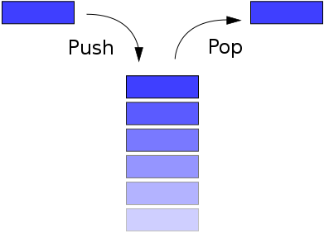
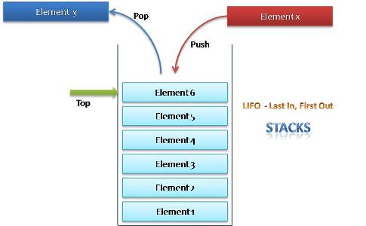

Slide 4
STACKS
In the computers memory stack can be represented as a linear array.
Every stack has a variable TOP associated with it. TOP is used to store the address of the top most element of the stack. it is this position from where the element will be added or deleted.
If TOP = NULL then it indicates that stack is empty and if TOP=MAX , then stack is full.
STACK REPRESENTION:
A | AB | ABC | ABCD | ABCDE
0 | 1 | 2 | 3 | TOP=4 | 5 | 6 | 7

Slide 5
STACKS
(1)push (this operation adds elements to the top of the stack)
(2)pop(this operation removes the element from top of the stack)
(3)peep(returns the value (display)of topmost element of the stack)
Advantage:
last in, fist out(LIFO) access.
Disadvantage:
slow access to other elements.

Slide 6
Stack: Properties
Stack: Properties
They both provide LIFO (last in first out) Structures.
6
6
5
5
4
4
3
3
2
2
1
1

Slide 7
